Slide 1
Household Sustainability
Transition Town Hastings

Slide 2
Sustainability
Zero Carbon – Reduce > eliminate energy for buildings
Transport – Reduce emissions
Food – Reduce impact of production, packaging and transport
Materials – Minimize impact of manufacture and transport
Zero waste – Reduce, re-use, reprocess, convert to energy
Water – Reduce consumption (and waste)
Natural habitats & wildlife – Conserve and enhance
Culture & heritage – Preserve valuable aspects
Equity & fair trade – Promote social justice
Health & happiness – Improve health and wellbeing
Notes:
What do we mean by sustainability? Sample list from One Planet Living
Main focus on 1 to 6 in this workshop
“Sustainability is the ability to continue a defined behaviour indefinitely” – economic, environmental, social
Brundtland Commission in 1987: "..development that meets the needs of the present without compromising the ability of future generations to meet their own needs"
Intro text to carbon conversations.

Slide 4
UK Emissions 1
Notes:
Kyoto 2020 target of -20% on 1990 met by 2008

Slide 5
UK Emissions 2
Notes:
Impact of adding in traded emissions
Note impact of 2008 recession – trend is probably still upwards when GDP resumes growth
Illustrates the carbon impact of stuff

Slide 6
UK Emissions 3
Notes:
Where we have to get to – Climate Change Act
Domestic emissions are approximately 25%

Slide 7
Quiz
Notes:
Purpose – to set sustainable emissions into a global context

Slide 8
Answers
Q | Acceptable Range
1 | 8% - 10%
2 | 130 – 140 litres
3 | 8 – 12 seconds
4 | 6 – 8 weeks
5 | 3,500 – 4,500 Kg
6 | 80 – 120 weeks
7 | 3 – 4 times
8 | 12 – 15 te
Notes:
Keep figure of ~ 2 te/yr of CO2e as a sustainable level in mind
28 litres for tea, >1400 litres for 100g of chocolate

Slide 9
Domestic Emissions 1
Notes:
Excludes transport
Note: Energy as opposed to emissions

Slide 10
Domestic Emissions 2
Notes:
Illustration of make-up of domestic emissions – 15te
Link to quiz answers
Numbers vary from different sources: England or UK wide, CO₂ only or GHG, basket of what is included
Doesn’t fully address embodied emissions

Slide 11
Domestic Emissions 3
Notes:
Only modest improvement – some recession effect

Slide 12
Domestic Emissions 4
Notes:
Whilst some electrical appliance consumptions have been reducing, consumer electronics have done the opposite
Consider amount on & of standby usage, Samsung allegations

Slide 13
Energy Use
Notes:
Explanation of difference between power and energy (kW vs kWh) as a precursor to energy bill exercise

Slide 14
Domestic Emissions 5
Notes:
Example of how one can make improvements by choice of appliance

Slide 15
Embodied emissions
Carbon footprint | Kg CO₂
A year’s worth of clothing | 225
A year’s worth of loo roll | 75
A new carpet – 4m x 4m | 76 - 290
A £500 gold necklace | 200 - 400
A small car | 6,000
A large car | 35,000
A paperback book | 1
A year’s worth of newspapers | 142 - 270
A year’s worth of mobile phone use @ 1 hr/day | 1,250
A single web-search | 0.0007 – 0.0045
A new iMac | 720
A major kitchen refit | 10,000
A new house | 80,000

Slide 16
Travel
CO₂ emissions per vehicle | Grams per mile
Large car | 430
Small car | 280
CO₂ Emissions per passenger | Grams per mile
Urban bus/underground | 170
Train | 100
Long distance coach | 80
Short haul flight | 416
Long haul flight | 363
Cruise liner | 640
Foot passenger on a car ferry or cargo ship | 32
Notes:
Quantitative as well as qualitative considerations
Unsustainable aspect of globalisation

Slide 17
Cargo transport
Mode of transport | CO₂ emissions (grams per tonne-km)
Air: Short haul | 1360
Air: Long haul | 692
Road: Transit van | 532
Road: Large truck | 88
Container ship | 16
Ship: Bulk carrier | 4
Notes:
Perishables out of season
Food package labelling – grapes, salads, flowers
Rule of thumb: Air 100 – 150 times surface transport

Slide 18
Food
Carbon footprints of foods | Grammes CO_{2e} per kilo
Apples – local & seasonal | 70
Apples – annual average | 550
Bananas | 480
Potatoes | 370
Tomatoes – local, organic & seasonal | 400
Tomatoes – Heated UK greenhouse in March | 50,000
Wheat | 800
Rice | 4,000
Lamb | 19,000
Chicken | 4,500
Eggs (box of six) | 1,800
Bottled water | 320
Tap water | 0.24

Slide 19
How Do We Change?
Notes:
Dis-incentives, penalties & regulation do not work with governments – they lose votes
Incentives do not work well with the Treasury – where to find the money?
What do we do?
Behaviour change – refer to later exercise with energy bills
Bounceback effect

Slide 20
http://www.carbonconversations.org/

Slide 21
Handout
Information on behaviour changes that will increase sustainability and often reduce cost

Slide 22
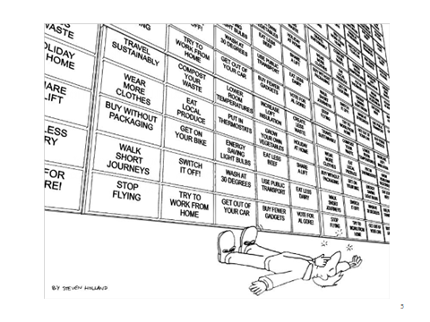

Slide 23
Thank you
"You must be the change you wish to see in the world." – Mahatma Gandhi
Ian Smith
transitionenergy@gmail.com

Slide 24
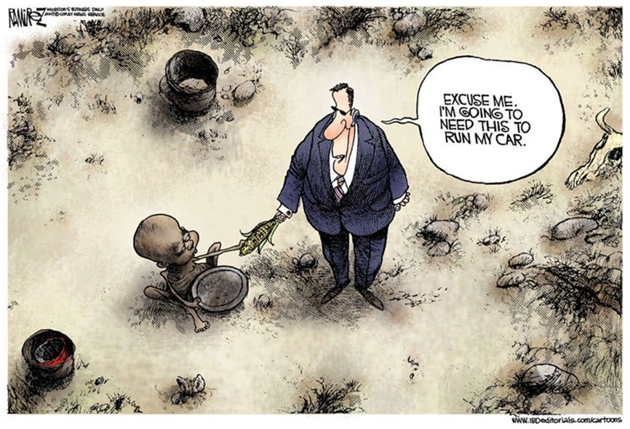

Slide 25
Factors affecting energy use in the home
Type of house
Size & age
Type – detached/semi/terraced/bungalow
Airtightness
Insulation levels
Windows – size/glazing quality
Construction – brick/stone/timber
Other – orientation/form factor/site exposure/location in UK

Slide 26
Factors affecting energy use in the home
Lifestyle/behaviour
Occupancy – number of people/transient/all day
Thermostat temperature settings
Showers vs baths/amount of their usage
Temperature tolerance of occupants
Clothing
Amount of appliances/electrical goods
Extent to which appliances/electrical goods are left on standby
Switching electrical items (eg. lights, TVs) off when not needed
Lighting levels
Use of curtains/shutters/blinds
Use of washing line
Use of wet appliances (eg. full loads only, low temperatures)
Use of supplementary heating (eg. portable electric heaters)

Slide 27
Factors affecting energy use in the home
Efficiency of equipment
Type of lighting – incandescent/halogen/fluorescent/LED
Configuration of lighting/luminaire efficiency
Energy efficiency of appliances
Standby electrical consumption
Heating controls – programmers/radiator thermostats
Efficiency of boiler

Slide 28
Factors affecting energy use in the home
Heating fuel/electricity use adjustment factors
Energy for cooking – gas/oil/electricity/wood
Storage heaters
Immersion heater
On site electricity generation (eg. PV)
Solar thermal heating
Electric vehicle charging

Slide 29
